Slide 1
802.15.4 Project
The Northernites
Sam Weismuller, SangRyul “Eric” Pae, Jay Cordaro
MAS 2023 Students UC San Diego
June 2, 2023

Slide 2
Project Progress and Deliverables
OQPSK end-to-end demo
MVP complete
Now focus is on enhancing MVP with audio input/output
Could not sync between Efinix LVDS & AT86RF215 Board
Focus on enhancing OQPSK MVP with audio
Audio out Teensy over I2S using MAX98357 EVB
Extend MVP with audio output
PDM audio in to FPGA
Demonstrate audio input from PDM microphone & actual usage of FPGA in final project :)

Slide 3
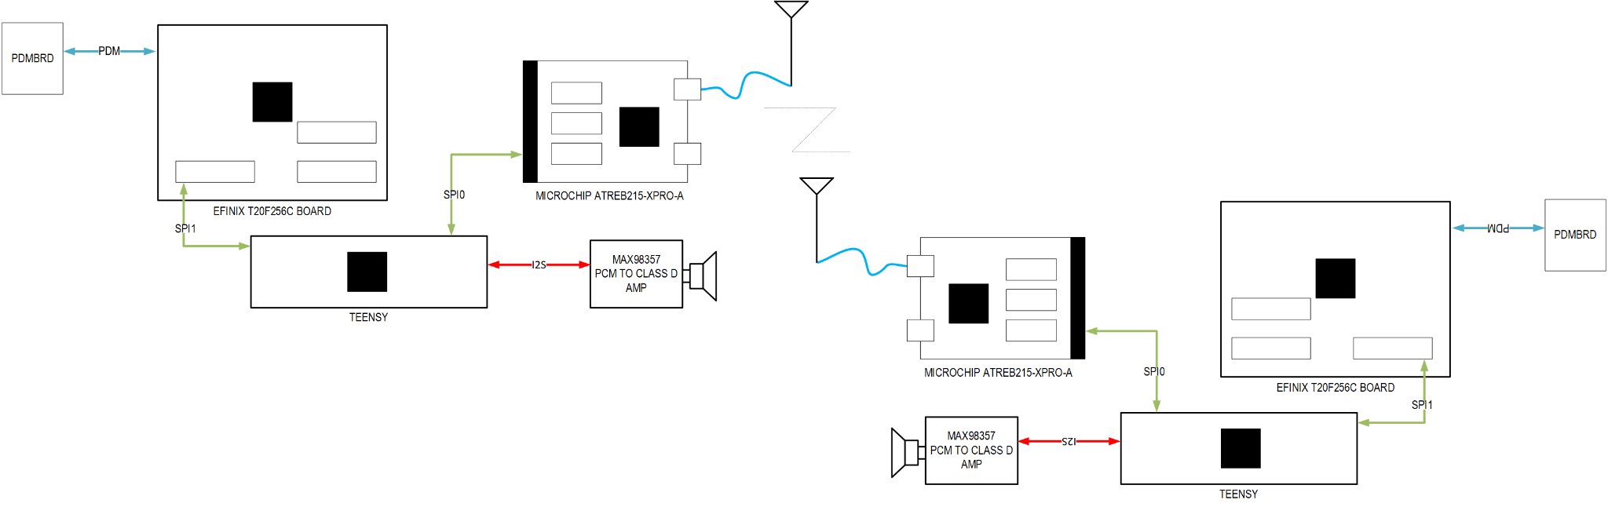
Project Block Diagram

Slide 4
OQPSK Detail
Supported by the baseband processors on the Atmel part
Can be used in 915 MHz and 2.4 GHz band
Higher data rate than BPSK
40 kbps to 250 kbps
From 2 orthogonal chip sequences to 16

Slide 5
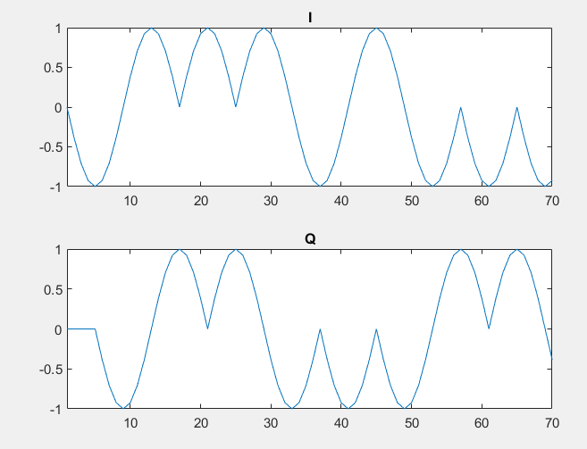
OQPSK Waveform
Raised Cosine pulse shape in both channels
Each pulse is 2 chip durations long
Q channel is offset from I channel by one chip duration

Slide 6
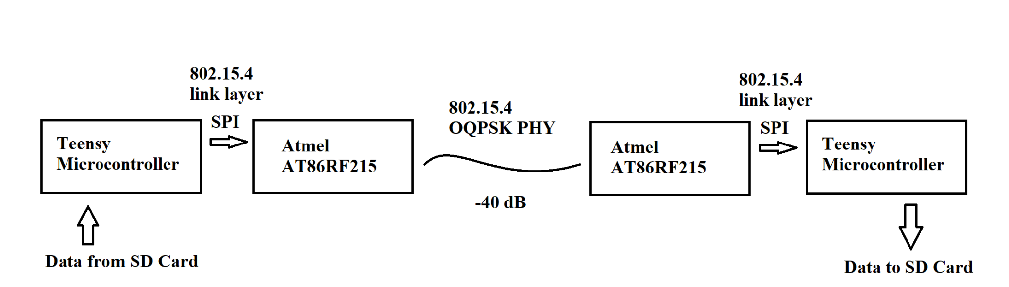
MVP
File-based transceiver using OQPSK mode on the Atmel part
Teensy sends 802.15.4 packets to the RF board over SPI
RF board handles modulation and demodulation
Can send audio with Opus codec or Bit Error Rate Test patterns

Slide 7
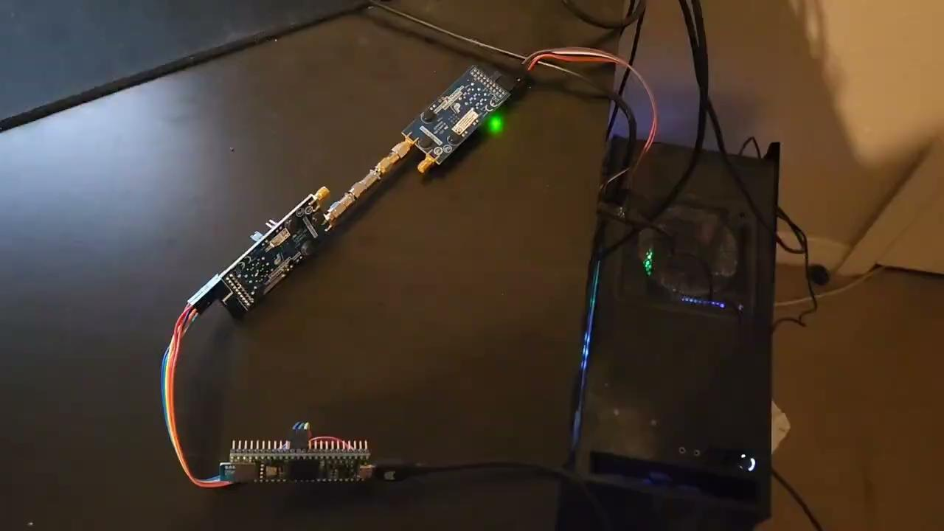
Demo

Slide 8
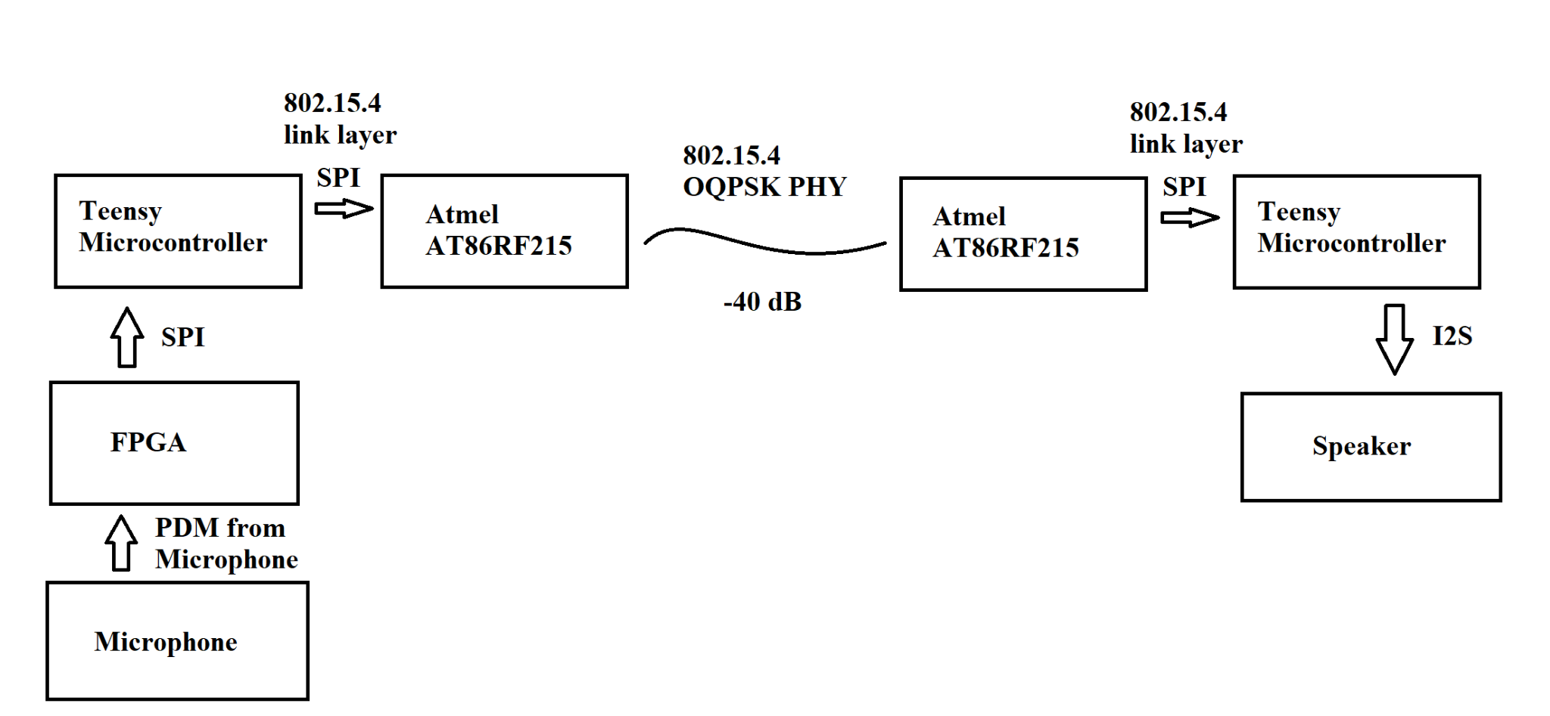
Beyond the MVP
We want to get proper audio input and output for a true “walkie-talkie”
SD card will be used to buffer data to lessen timing constraints

Slide 9
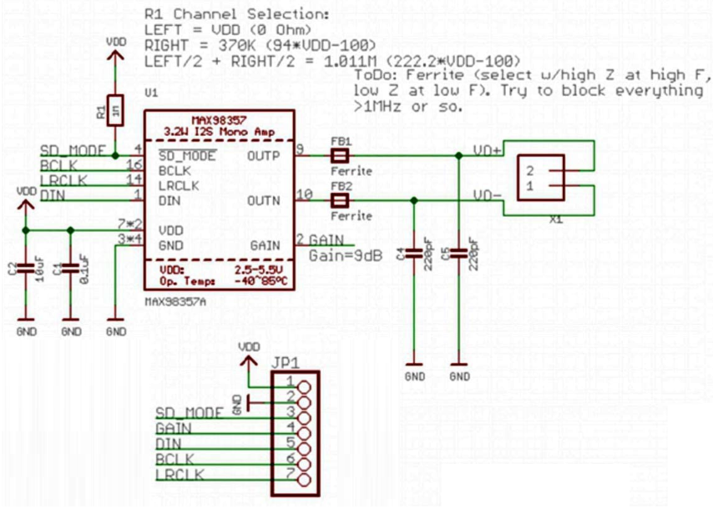
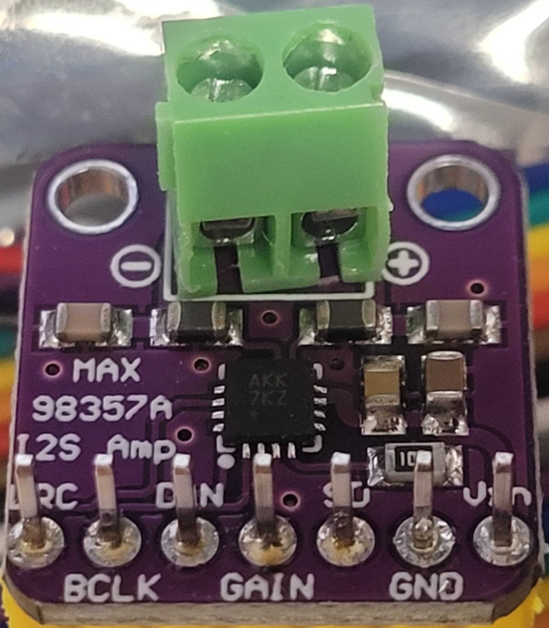
Audio Out Teensy Detail

Slide 10
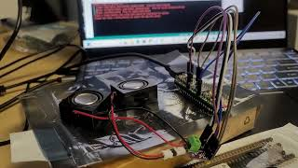
Audio Out Teensy Detail
I2S Pipe Cleaning between Teensy & MAX98357 for speaker is done with sample sounds

Slide 11
Audio Out Upsampling
Opus codec gives us a 16 ksps audio
This needs to be upsampled to 44.1 ksps for audio library
In order to do this quickly and simply:
Insert alternating amounts of zeros into the received samples to get the sample rate to 44.1 ksps
Cascade a low-pass FIR filter before the audio is output the I2S channel to remove aliasing noise

Slide 12
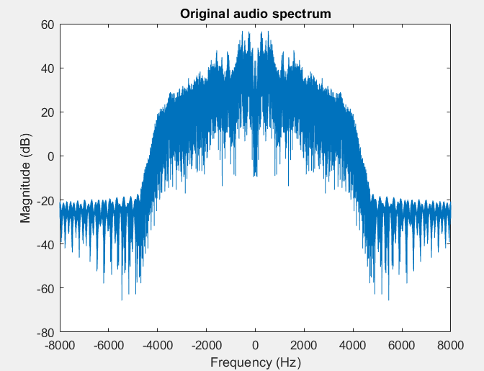
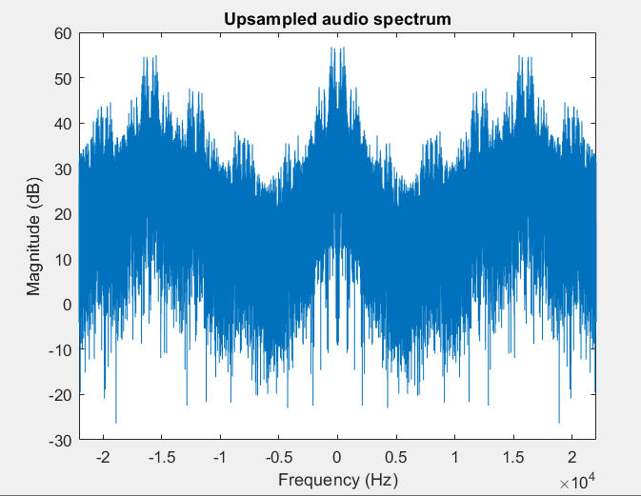
Audio Out Upsampling

Slide 13
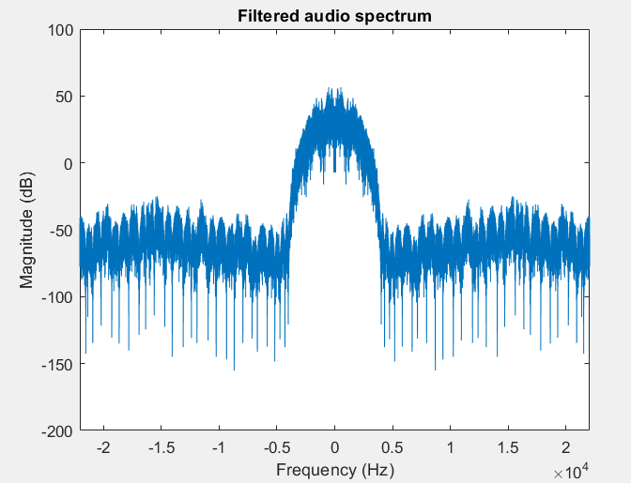

Audio Out Upsampling

Slide 14
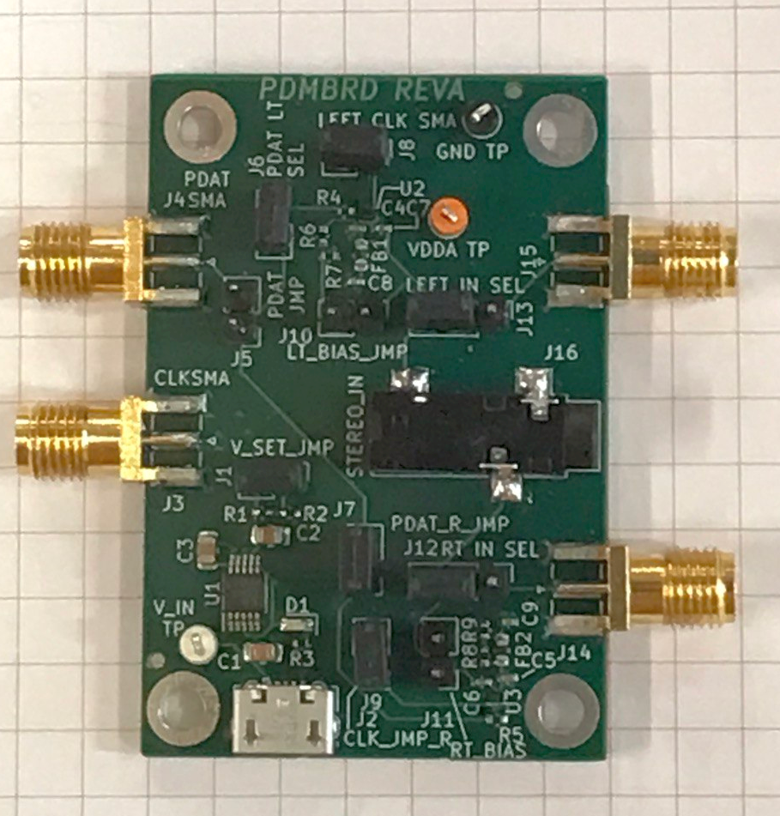
PDM Audio to Teensy Detail
Decimate from 1-bit 768kHz to 16kHz PCM as shown in 1st meeting
Implement in fixed-point
Used Q15 format for filter taps
decimate by 12 as 48-tap polyphase filter ↓12
27-tap half band filter ↓2 (only 7 multiplies)
27-tap half band filter ↓2
Send to Teensy over SPI
Shifted from 8-bit payload to 32-bit payload to maximize throughput
FPGA
SPI
teensy 4.1
PDM
Analog
audio

Slide 15
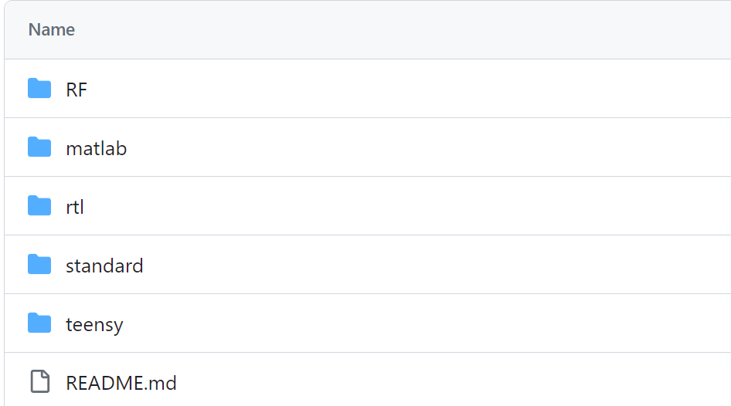
Github Repo
https://github.com/jaycordaro/WES207
Organization
key material:
teensy
rtl

Slide 16

Video Storyboard
All group members on camera briefly introducing the team and the concept. Describes our motivation to build something from scratch as that could be potentially used by future groups for a SDR with a powerful FPGA.

Slide 17
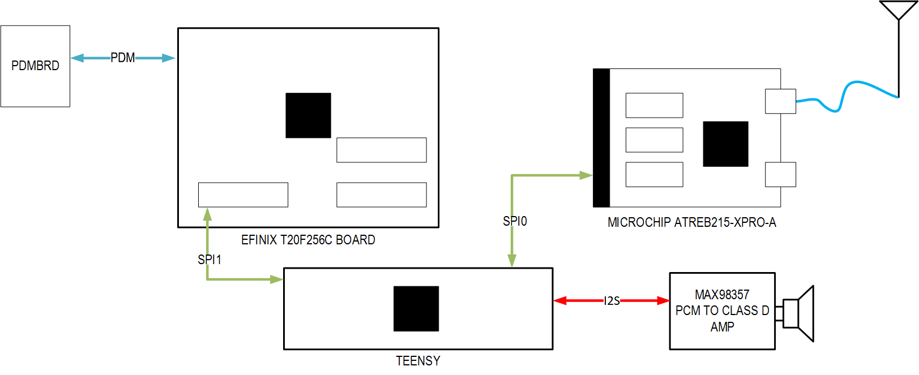
Video Storyboard
Go over the block diagram for the entire system and our motivation for making our own system

Slide 18
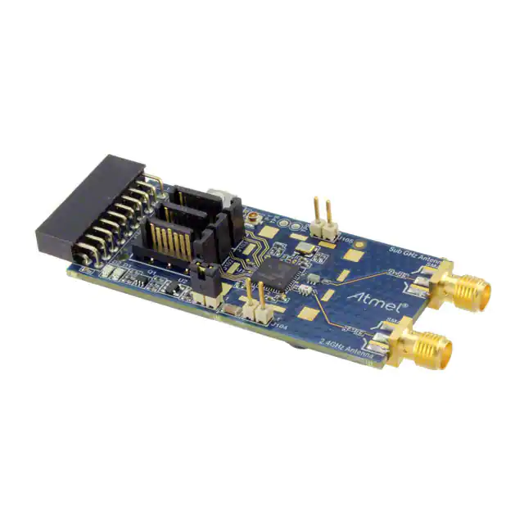
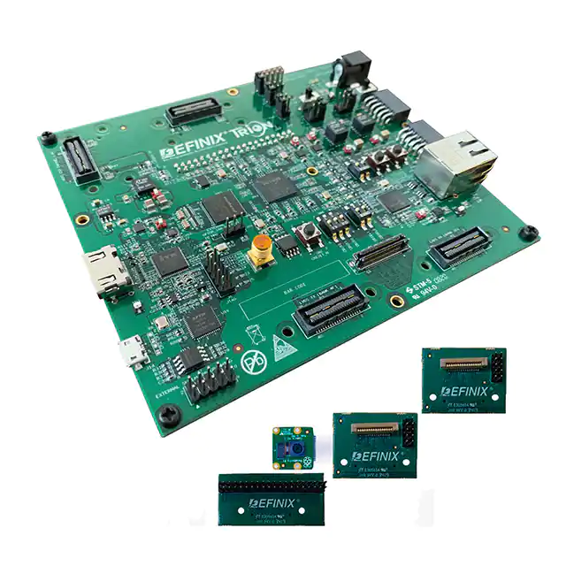
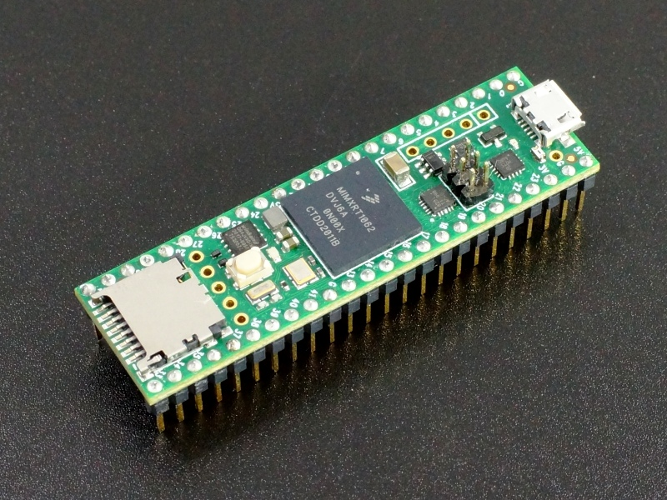
Video Storyboard
For each component, show a small clip of the actual part while describing it

Slide 19
Video Storyboard
Go over the signal path through the components using the diagram, highlight the block as it is being talked about

Slide 20
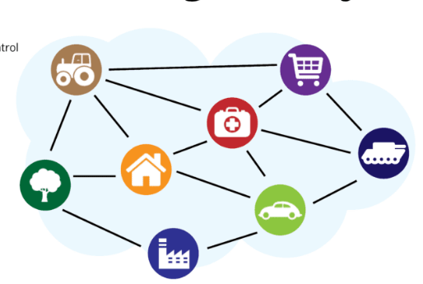
Video Storyboard
Briefly describe 802.15.4 over some generic internet-of-things B-roll

Slide 21
Video Storyboard
Describe the the 802.15.4 OQPSK waveform and showing the MATLAB simulations

Slide 22
Video Storyboard
Demo section- will showcase the following functionality:
Voice recording(mic → FPGA, PDM to PCM)
Voice file transfer(FPBA →Teensy1, via SPI )
Wireless file transfer( Teensy1 → Teensy2, via 802.15.4/OQPSK)
Received file play ( Teensy2 → Speaker, via I2S )

Slide 23
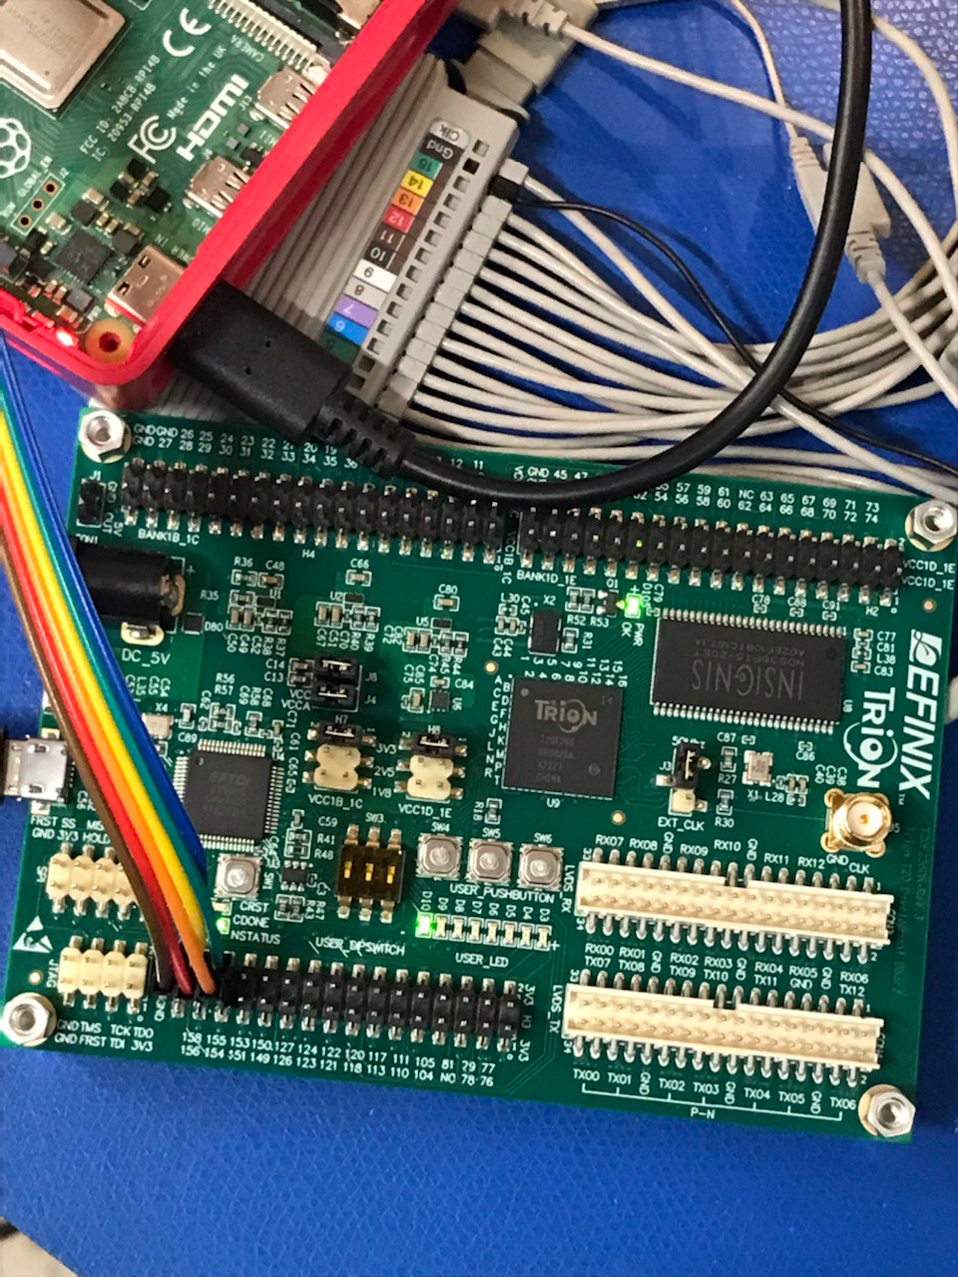
Video Storyboard
Demo: show a message being given to the transmitter

Slide 24
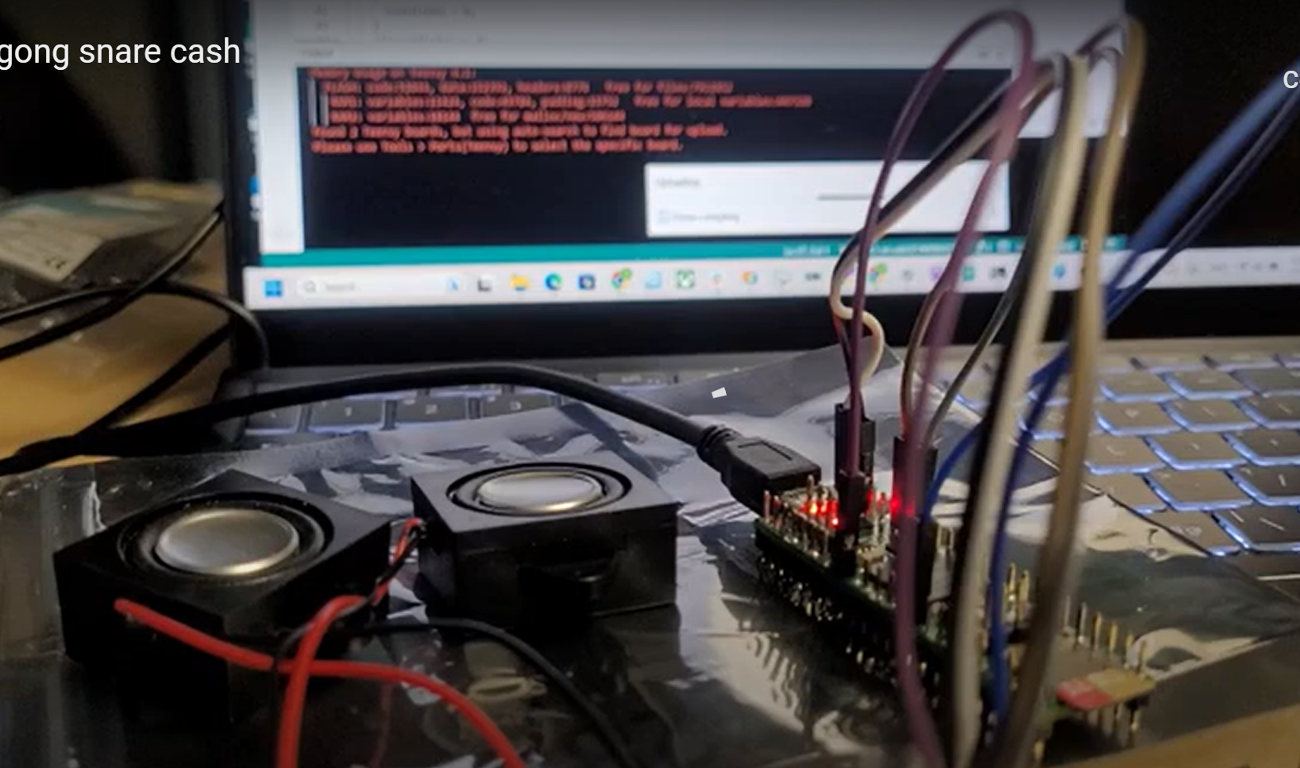
Video Storyboard
Demo: show the message being played at the receiver

Slide 25
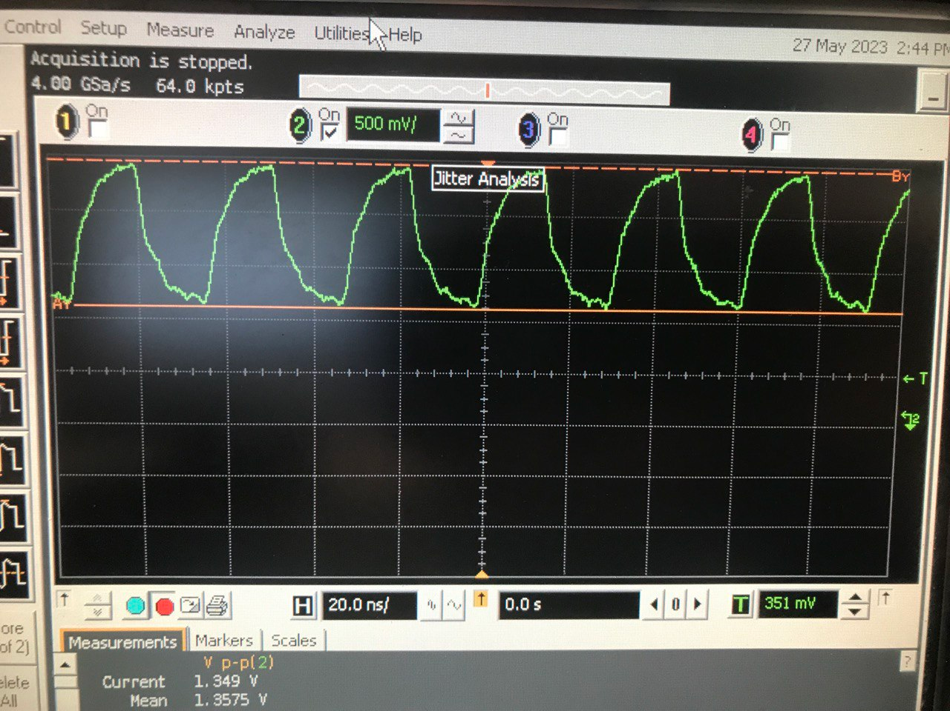
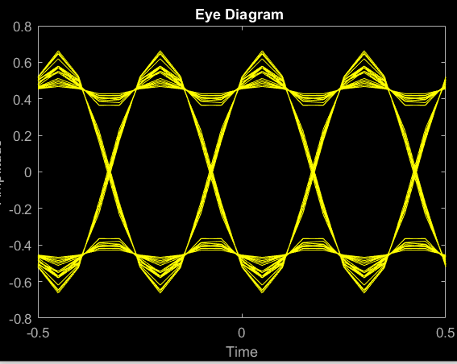
Video Storyboard
Show some footage of the LVDS struggles and the BPSK simulations while we talk about potential for future work

Slide 26
Video Storyboard
Brief conclusion, the team on camera saying thank you to the professors

Slide 27
Summary
LVDS didn’t work out, but we’re able to move forward with the OQPSK
MVP is done, but we can improve upon it with audio input and output
Intended final demo is the audio-based transceiver
We want this done by Sunday so we can focus on the video and presentation
We have all the pieces, we just need to put it together into the final form
Always have MVP as fallback

